Slide 1
Online Toy Store TOY QUEST (Mini project) Course code: 21CSE422A
CHRIS JORDAN J(1NH21CS062)
ADRIAN MATHEW ALOYSIUS (1NH21CS011)

Slide 2
PROBLEM STATEMENT
A toy store needs a website to showcase and sell their products to potential customers and unveil a captivating digital gateway to a world of imagination and play, bringing the enchantment of a toy store to the online realm. The website needs a meticulous design and thoughtful integration of elements that invites visitors to a diverse array of toys. As users traverse this digital storefront, they need to encounter an immersive experience that seamlessly blends aesthetics, functionality, and interactivity. With visually captivating background imagery to intuitive navigation and enticing product displays, the website should encapsulate the essence of joyful exploration and invite visitors to embark on a delightful adventure through the realms of toys and childhood wonder. Whether seeking to shop, discover trends, or engage in playful interaction, the forum should offer an enticing destination that bridges the gap between nostalgia and modernity, serving as a testament to the timeless allure of toys in a digital age.

Slide 3
OBJECTIVES
Login – Provide a way for users to create an account and handle user authentication.
User-Friendly Navigation - Establish a user-friendly navigation system, including a header with a logo and a dynamic navigation menu. The menu should provide links to essential sections of the website, such as Home, Trending, Shop, Ratings, Contact, and a shopping cart.
Attractive Homepage - Include an engaging homepage with a captivating background image, welcoming headline, and introductory text. It aims to capture the user's attention and entice them to explore the website further.
Product Showcase - Present a comprehensive product showcase section where users can view various toy products. Each product listing includes an image, title, description, star ratings, and price. Users can also add products to their cart for purchase.
Special Offers and Promotions - Highlight special offers and promotions through visually appealing banners. These banners entice users with discounts, free shipping, and exclusive merchandise, encouraging them to engage further.
Add to Cart – Present a table with a list of selected items and price in users shopping cart with a summary of the total purchase.

Slide 4
7. Email Subscription - Integrate an email subscription form where users can input their email addresses and select their favourite categories. This feature enables users to receive updates and notifications about their preferred toys and general queries.
8. Contact - Include a comprehensive footer that provides essential contact information for the business. It lists the company's address, email addresses, phone number, and social media links and include a form for users to send messages to the company.
9. Branding and Copyright - Establish a consistent brand identity for "Toy Quest" by incorporating its logo and brand colours throughout the website. Additionally, include copyright information to protect the intellectual property of the website content.
10. Rating Submission Form – Create a webpage that includes a form for users to submit ratings based on various criteria related to the services provided. Each criterion has an associated input field that allows users to enter a rating from 0 to 5.

Slide 5
HARDWARE & SOFTWARE REQUIREMENTS
HARDWARE REQUIREMENTS:
Computer: A standard personal computer or laptop is sufficient with a resolution of 1024x768 or higher is recommended for a comfortable viewing experience.
SOFTWARE REQUIREMENTS:
Text Editor or IDE: You'll need a text editor or IDE to write, edit, and manage your HTML and CSS code. Some of the popular options are Visual Studio Code, Sublime Text, Atom or Notepad++
Web Browser: To view and test HTML, CSS code we need a modern web browser such as Google Chrome, Mozilla Firefox or Opera.
Local Server: PHP, Web server like XAMPP to run PHP scripts and serve web pages, Live server extension for VSCode
Database Client: Software tool like phpMyAdmin to handle the administration of a MySQL web-based database server.
Font-awesome library for icons.

Slide 6

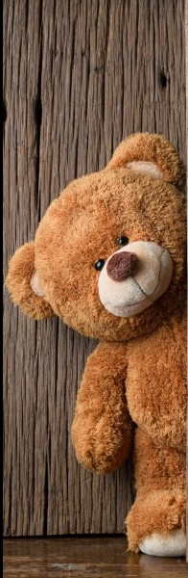
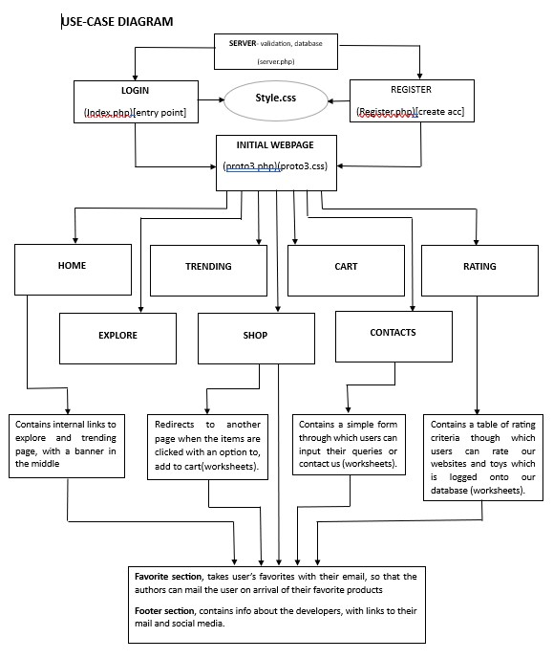

Slide 7
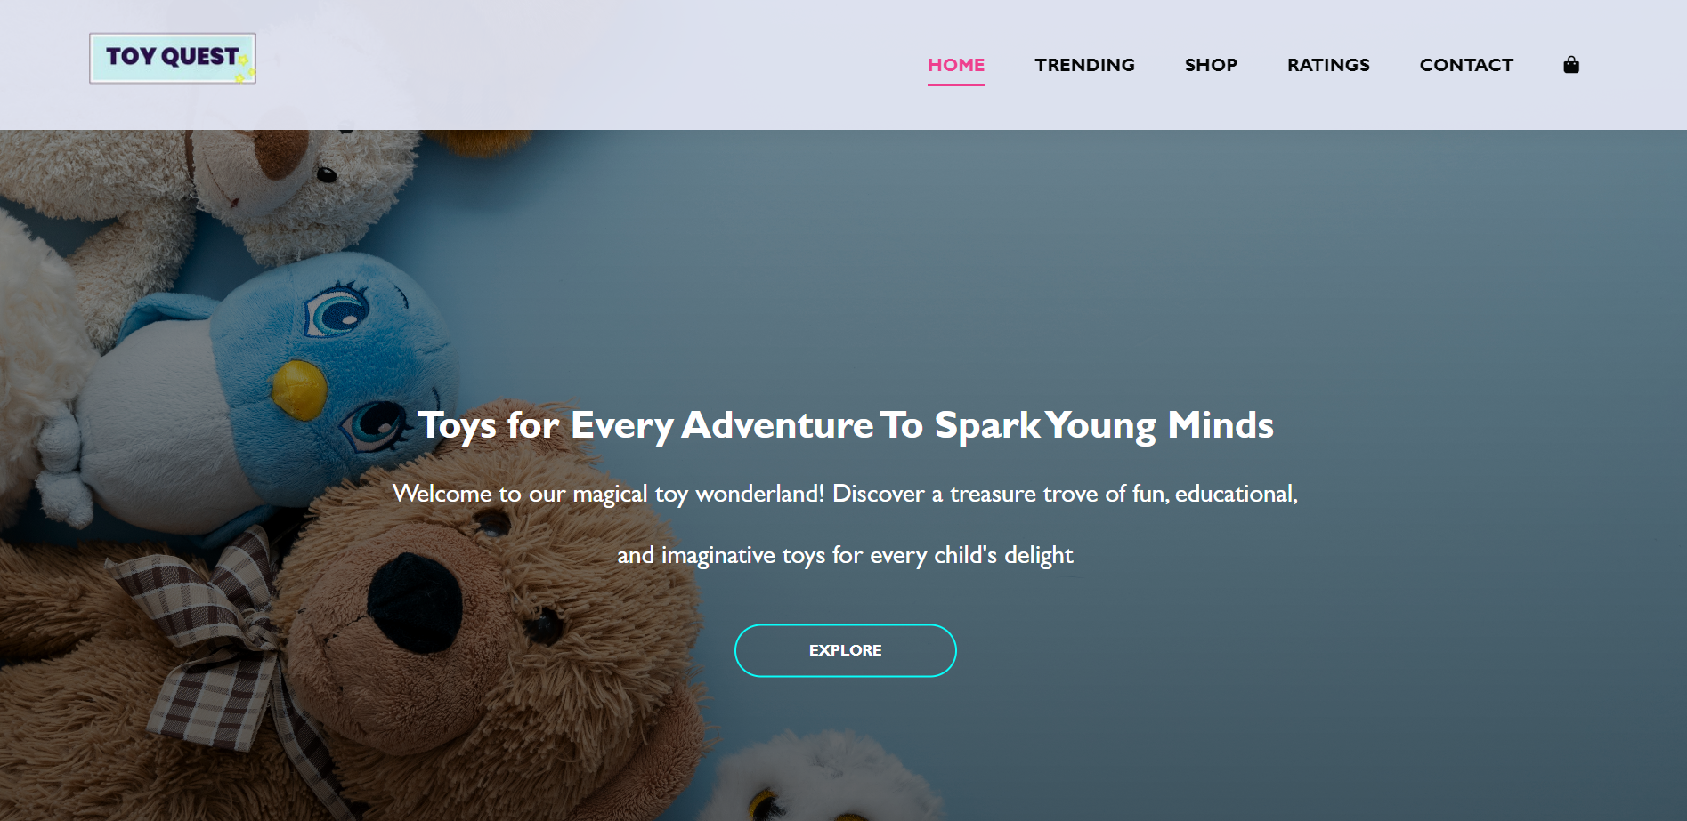
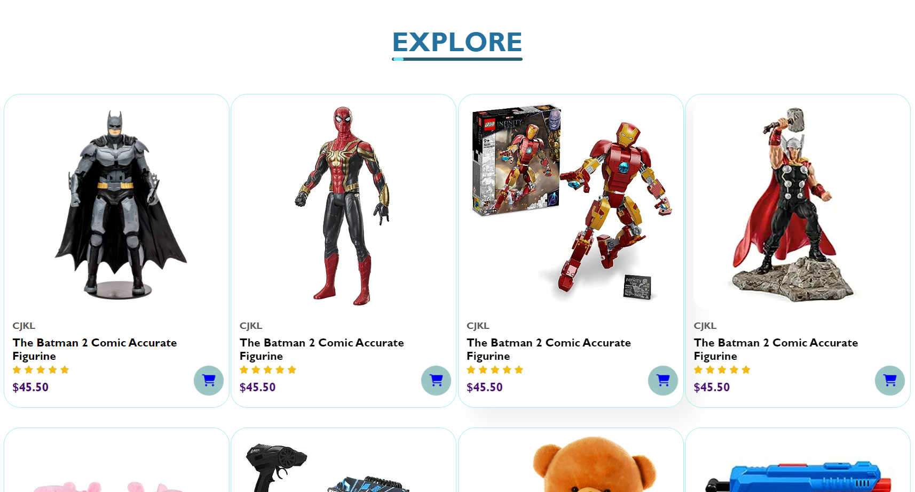
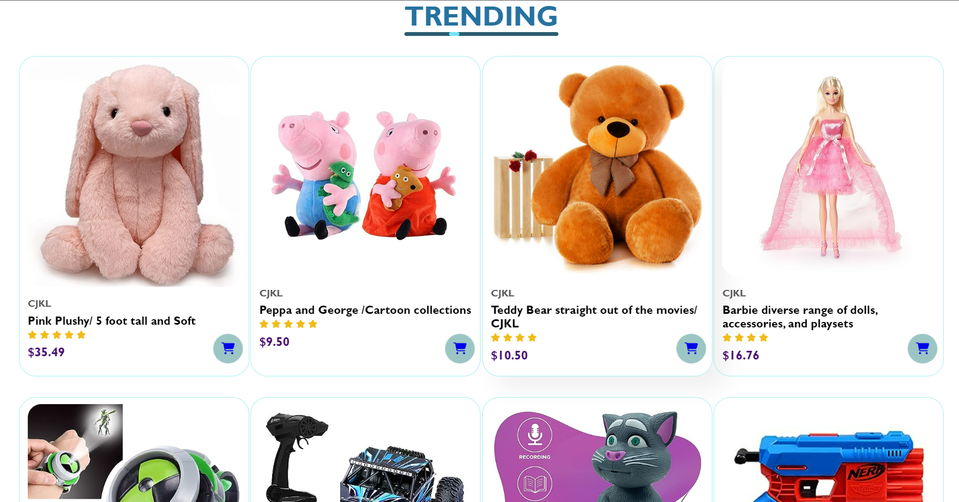
OUTPUT

Slide 8
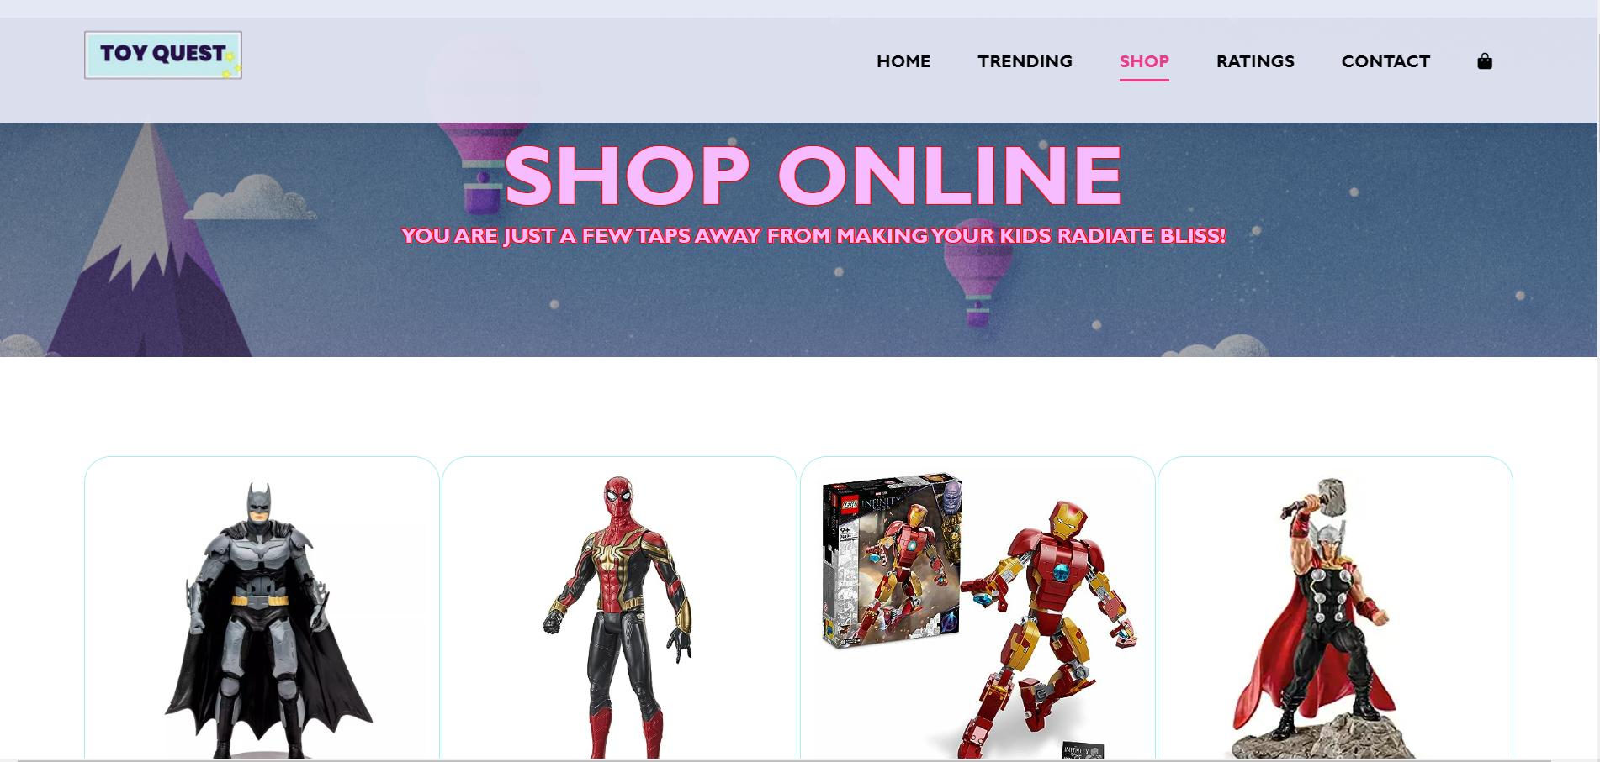
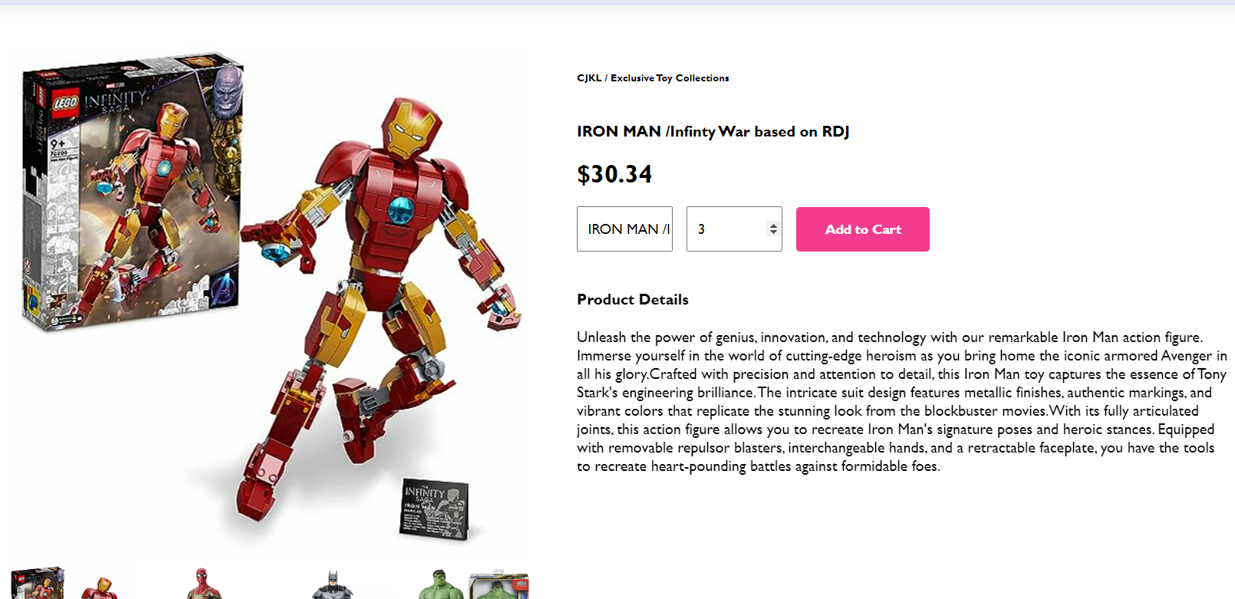
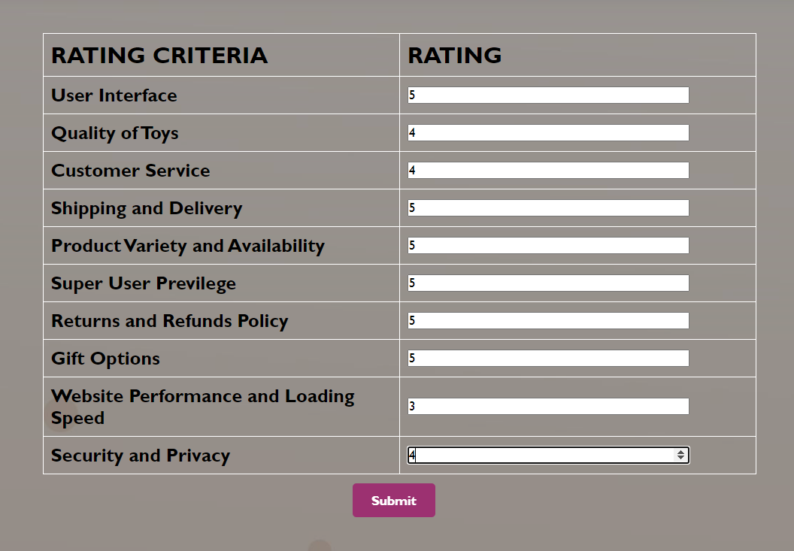

Slide 9
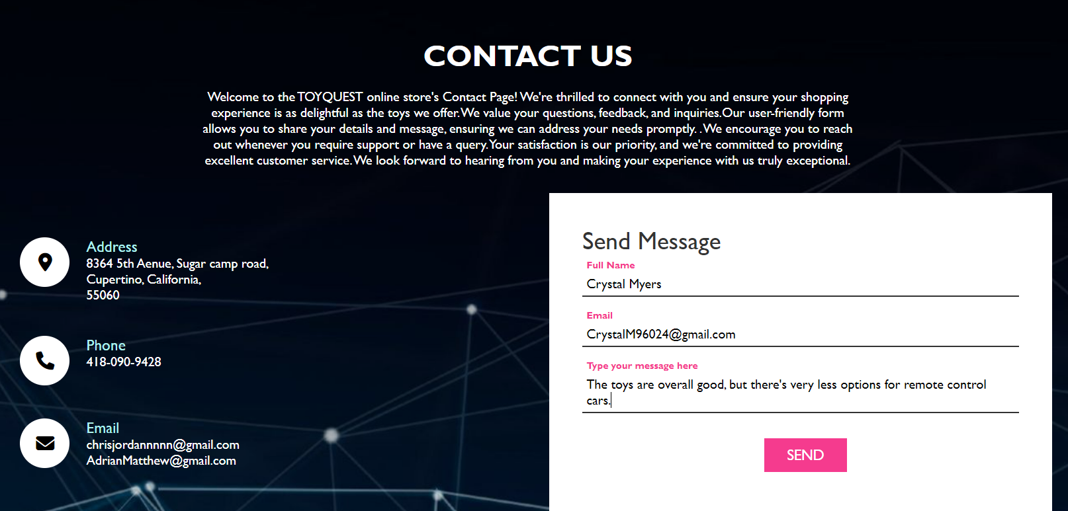
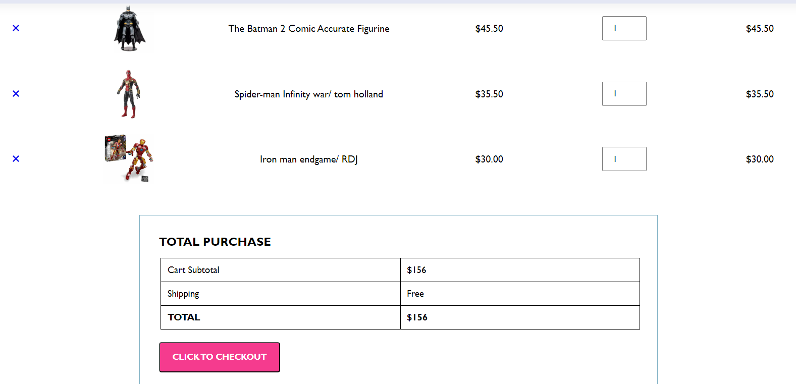
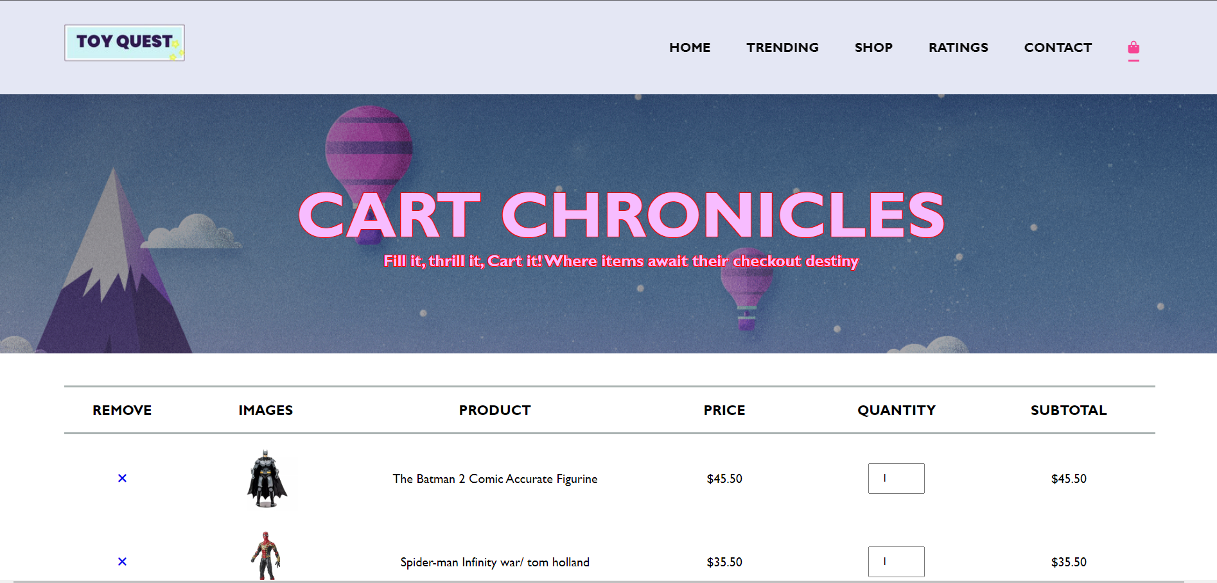

Slide 10
CONCLUSION
The Toy Quest website is a captivating and user-centric platform that brings the joy of play to life. With its visually engaging design, intuitive navigation, and comprehensive features, the site provides a seamless and enjoyable experience for visitors of all ages. From browsing the latest toy trends and exploring customer reviews to effortlessly shopping for a wide range of toys and games, every aspect of the website is thoughtfully designed to cater to the needs and interests of its users. The interactive shopping cart and checkout process, along with convenient contact and subscription options, further enhance the user journey. With its commitment to quality, creativity, and customer satisfaction, Toy Quest is not just a toy store, but a dynamic and engaging online playground that fosters excitement and cherished memories through play.

Slide 11

THANK YOU

